Slide 1
intro

Slide 2
pop quiz…
This presentation includes an interactive component using TurningPoint software. You will be asked a series of questions at the start of the presentation and again at the end to help us measure your change in knowledge. Questions are answered by using the remotes handed out.
Let’s do a practice question!

Slide 3
A group of ferrets is called a(n)…
pop quiz…
Fumble.
Pack.
Business.
Enterprise.

Slide 4
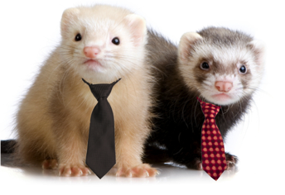

Slide 5
Food systems

Slide 6
You have the option to buy a tomato from location A, where it is in season, or Location B where it is not in season. Which tomato requires less energy to be grown?
pop quiz…
Location A.
Location B.
They’re the same.

Slide 7
Notes:
Put this slide up while you explain answer to previous question.

Slide 8
What is a food mile?
pop quiz…
The number of apples, lined up end to end, to measure a mile.
The distance your food must run in P.E. class.
The distance your food travels from where it’s grown to get to you.
How fast your food gets to you.

Slide 9
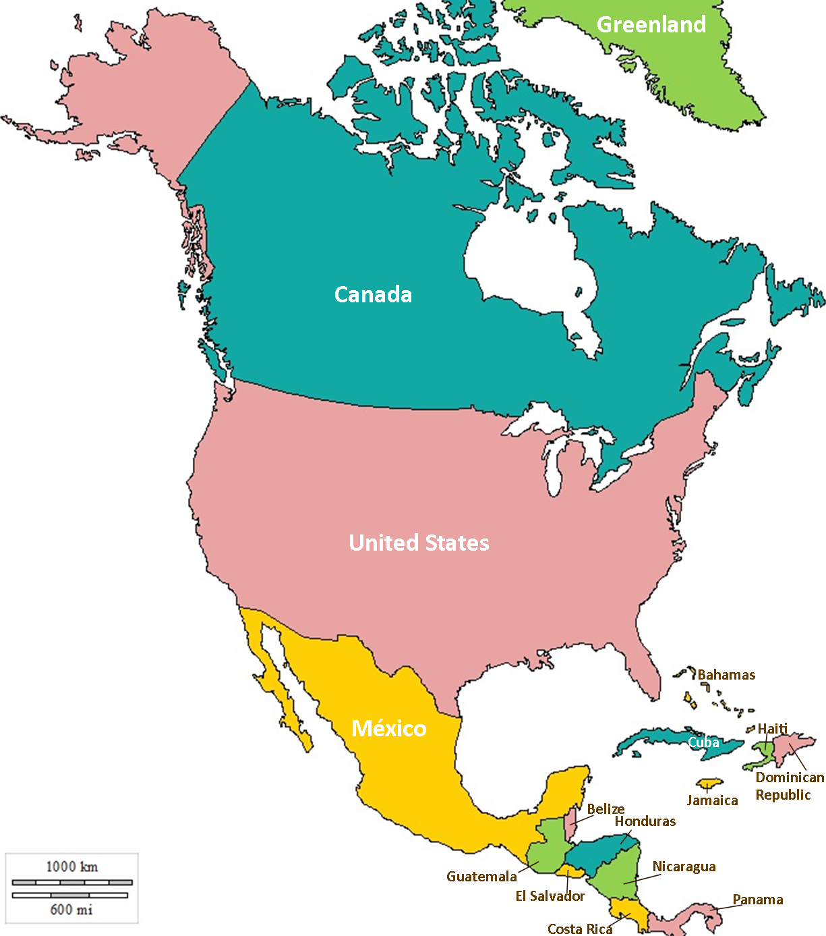
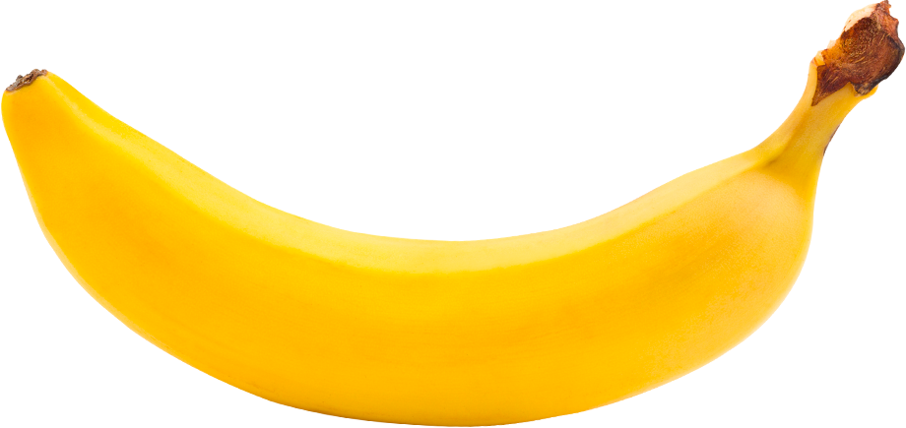
2600 miles!
Notes:
Put this slide up while you explain answer to previous question.

Slide 10
Notes:
Put this slide up while you explain answer to previous question.

Slide 11
Which of the following uses less overall energy and has less environmental impact?
pop quiz…
An apple grown 1000 miles away from the store.
An apple grown 50 miles away from the store.

Slide 12
Notes:
Put this slide up while you explain answer to previous question.

Slide 13
Which of the following is not a processed food?
pop quiz…
Chips Ahoy.
Honey Nut Cheerios.
An apple
Frozen vegetables.

Slide 14
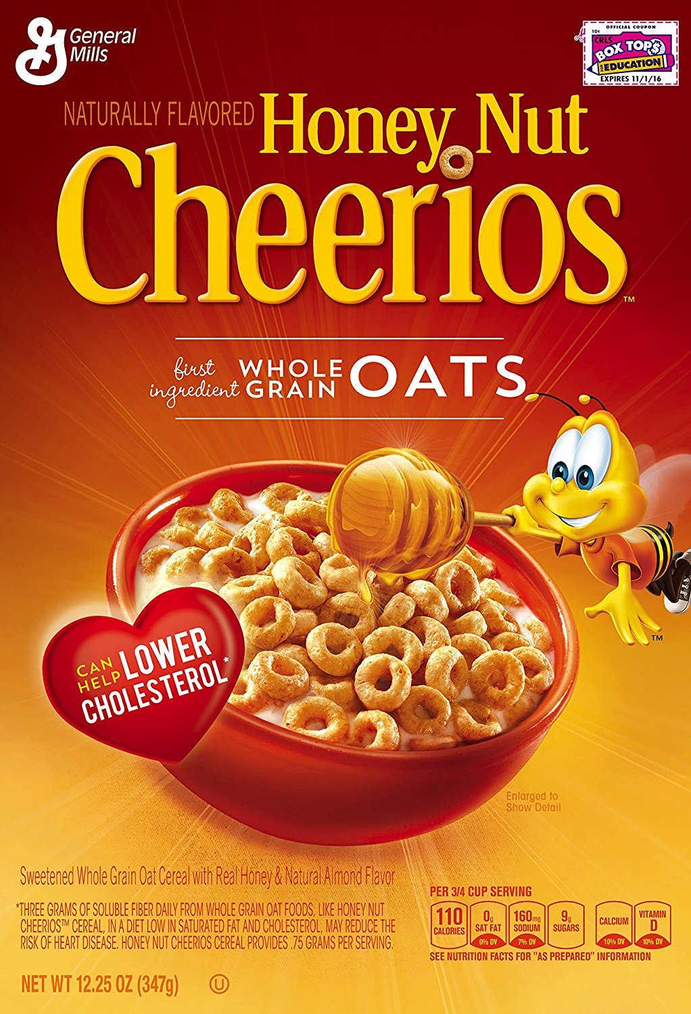
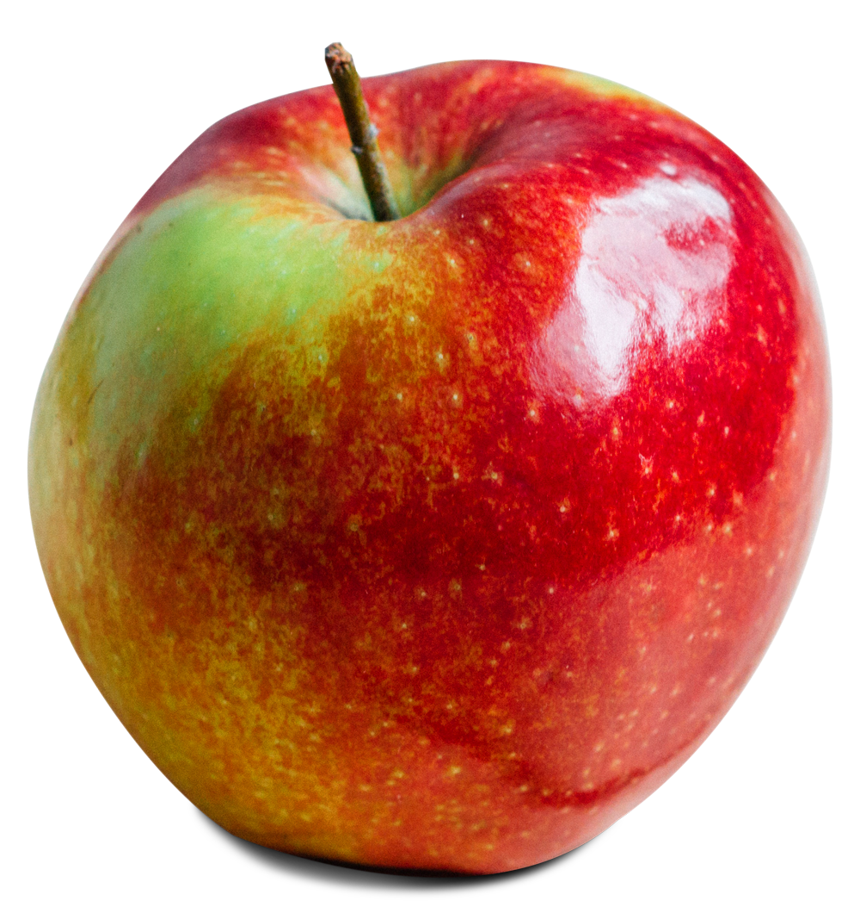
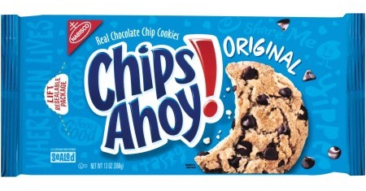
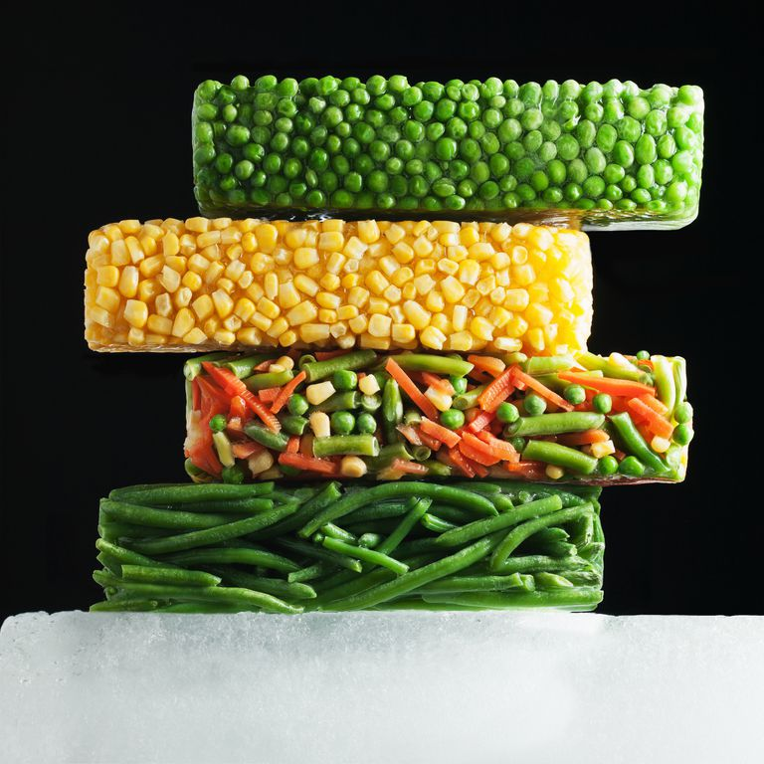
Notes:
Put this slide up while you explain answer to previous question.

Slide 15
Which of the following is a way to reduce your food energy impact?
pop quiz…
Eat less meat
Eat less processed food
Buy in season, local, and organic food.
Grow your own food.
All of these are great!

Slide 16
Notes:
Put this slide up while you explain answer to previous question.

Slide 17
where does my food come from?
It takes a lot of energy to get food to your table. The food system can be split into five stages.
1. Production
2. Processing
3. Transportation
4.Consumption
5. Waste

Slide 18
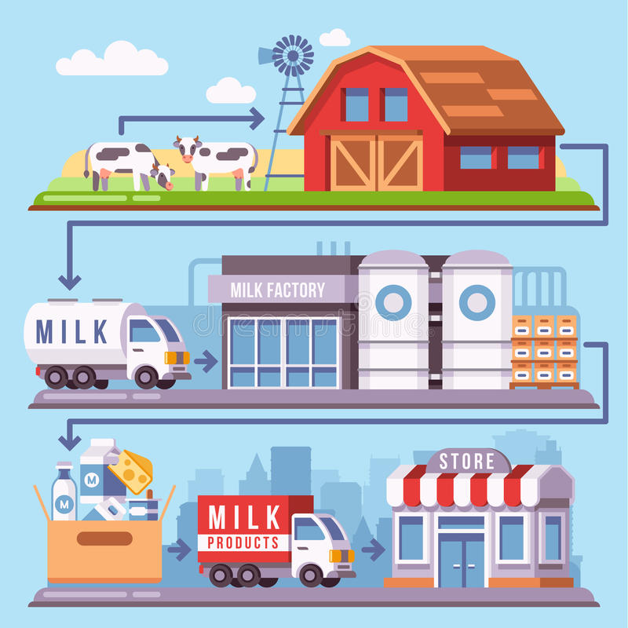
production
waste occurs at all stages
processing
transportation
consumption

Slide 19
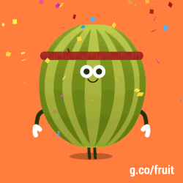
Let’s break it down…

Slide 20
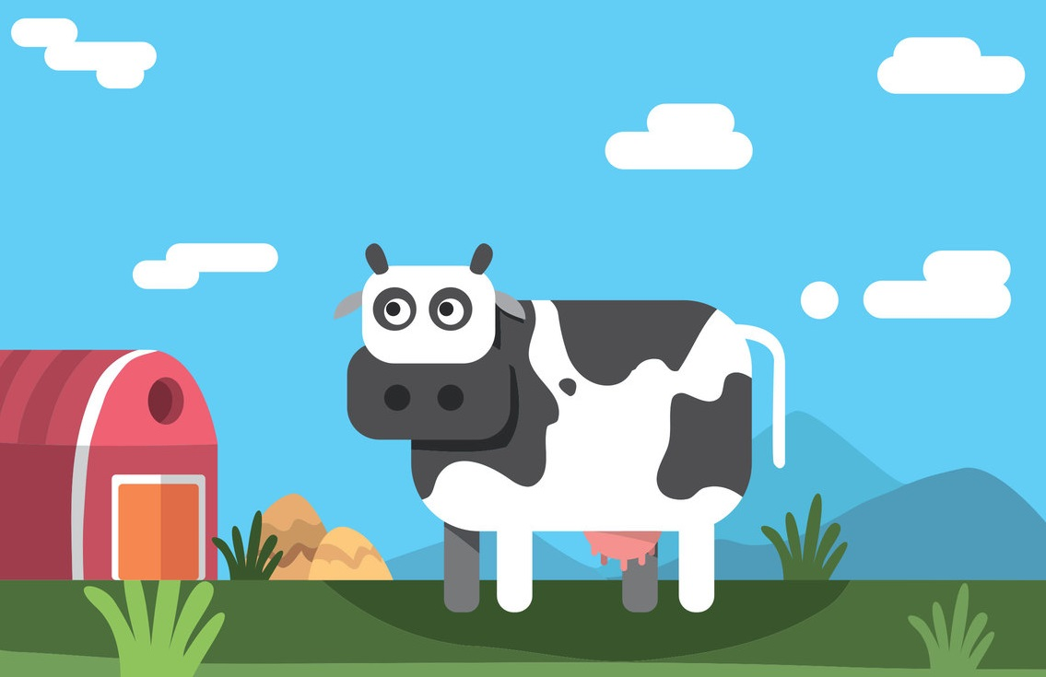
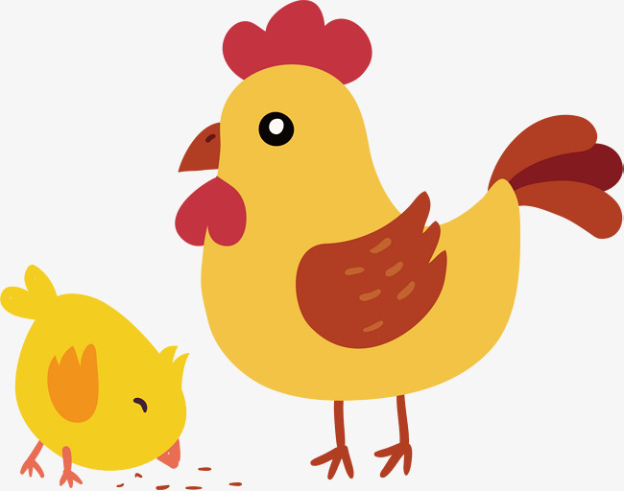
producing or growing food (production)
Water and fertilizers for crops, food for cows and other animals that we get food from.

Slide 21
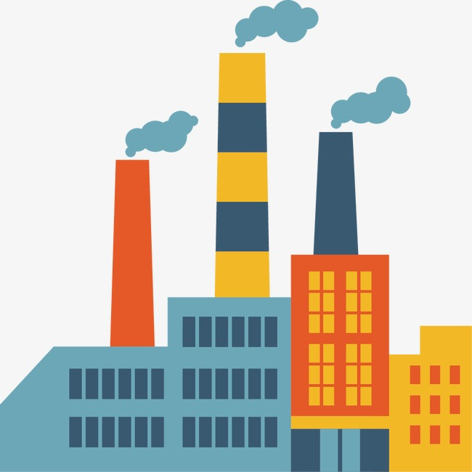
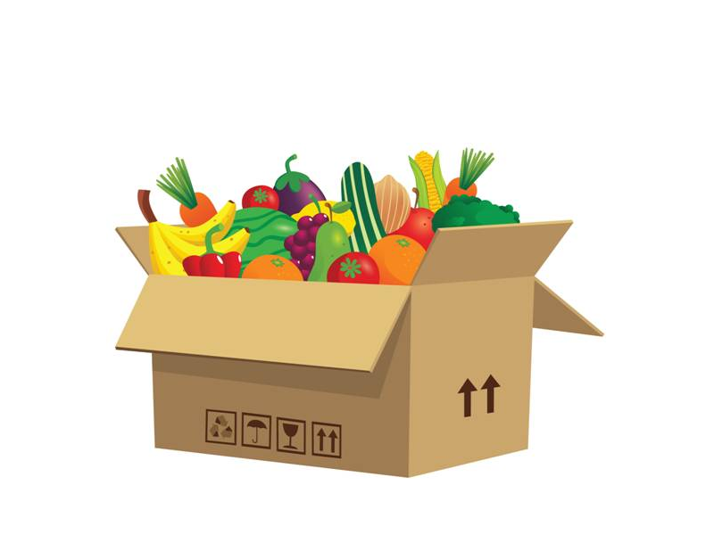
processing and packaging food (processing)
Power for the factory that processes our food, water for washing our food, materials for packaging our food.

Slide 22
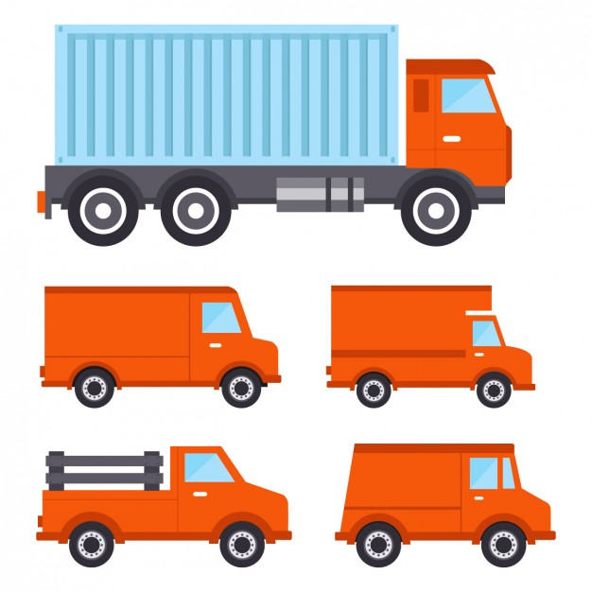
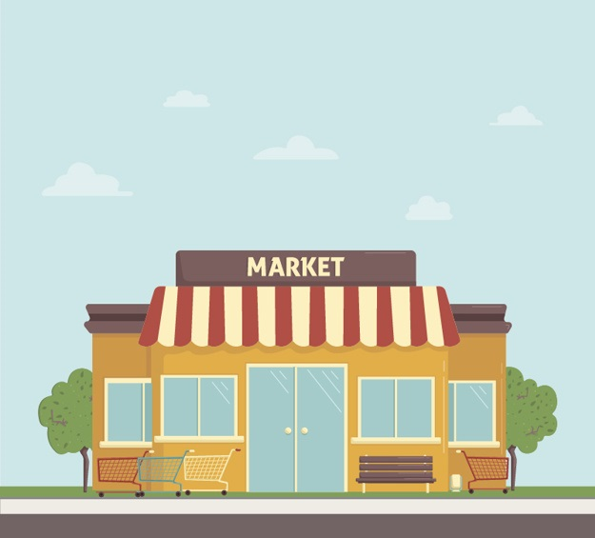
transporting food to the store (transportation)
Gas for driving or flying food to the store.

Slide 23
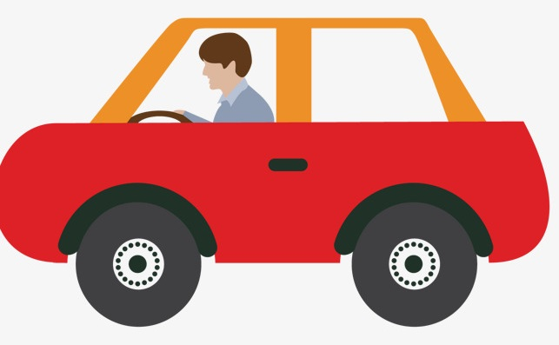
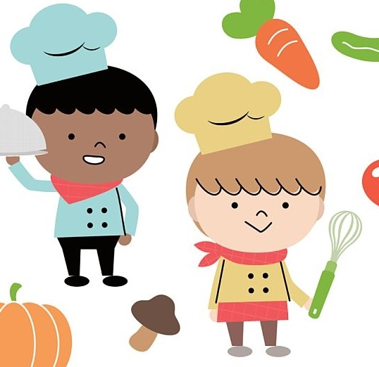
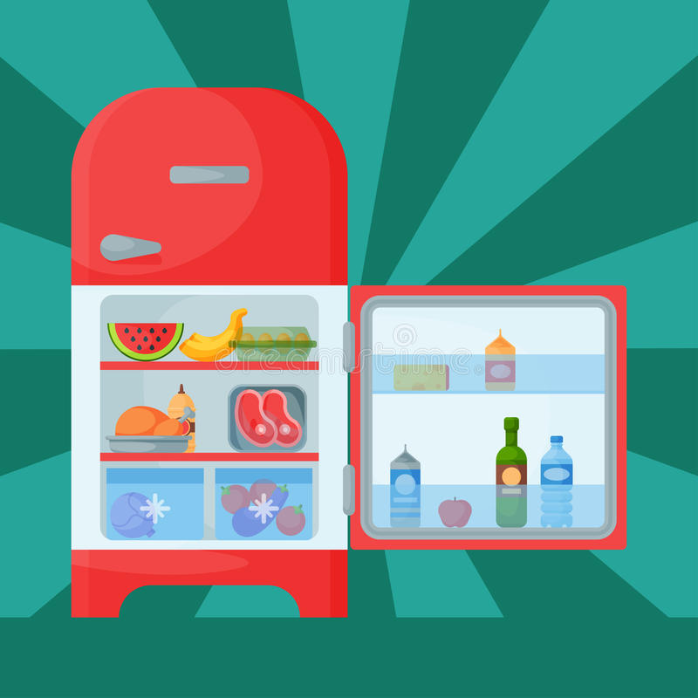
buying and eating food (consumption)
Gas for driving our cars to the store, energy for cooking food, refrigerators for keeping food fresh.

Slide 24
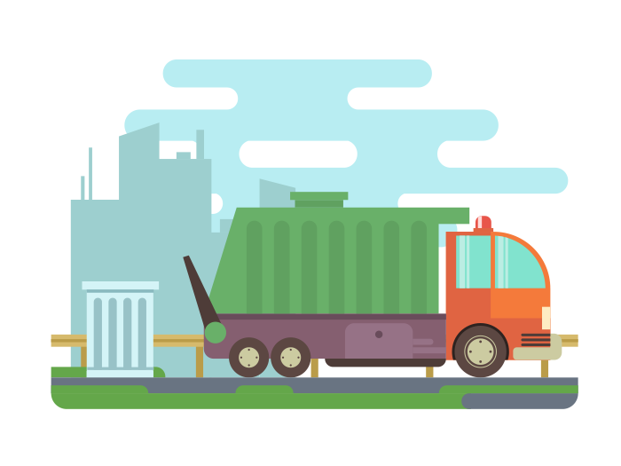
waste
Waste can occur at any point in the food system! What are ways it can occur at each step?
Examples: Crop waste, packaging waste, food spoilage during transport, letting food go bad before it’s eaten.
Overall, about 1/3 of the food that is grown never makes it to the consumer. That’s a lot of waste!

Slide 25
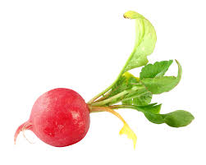
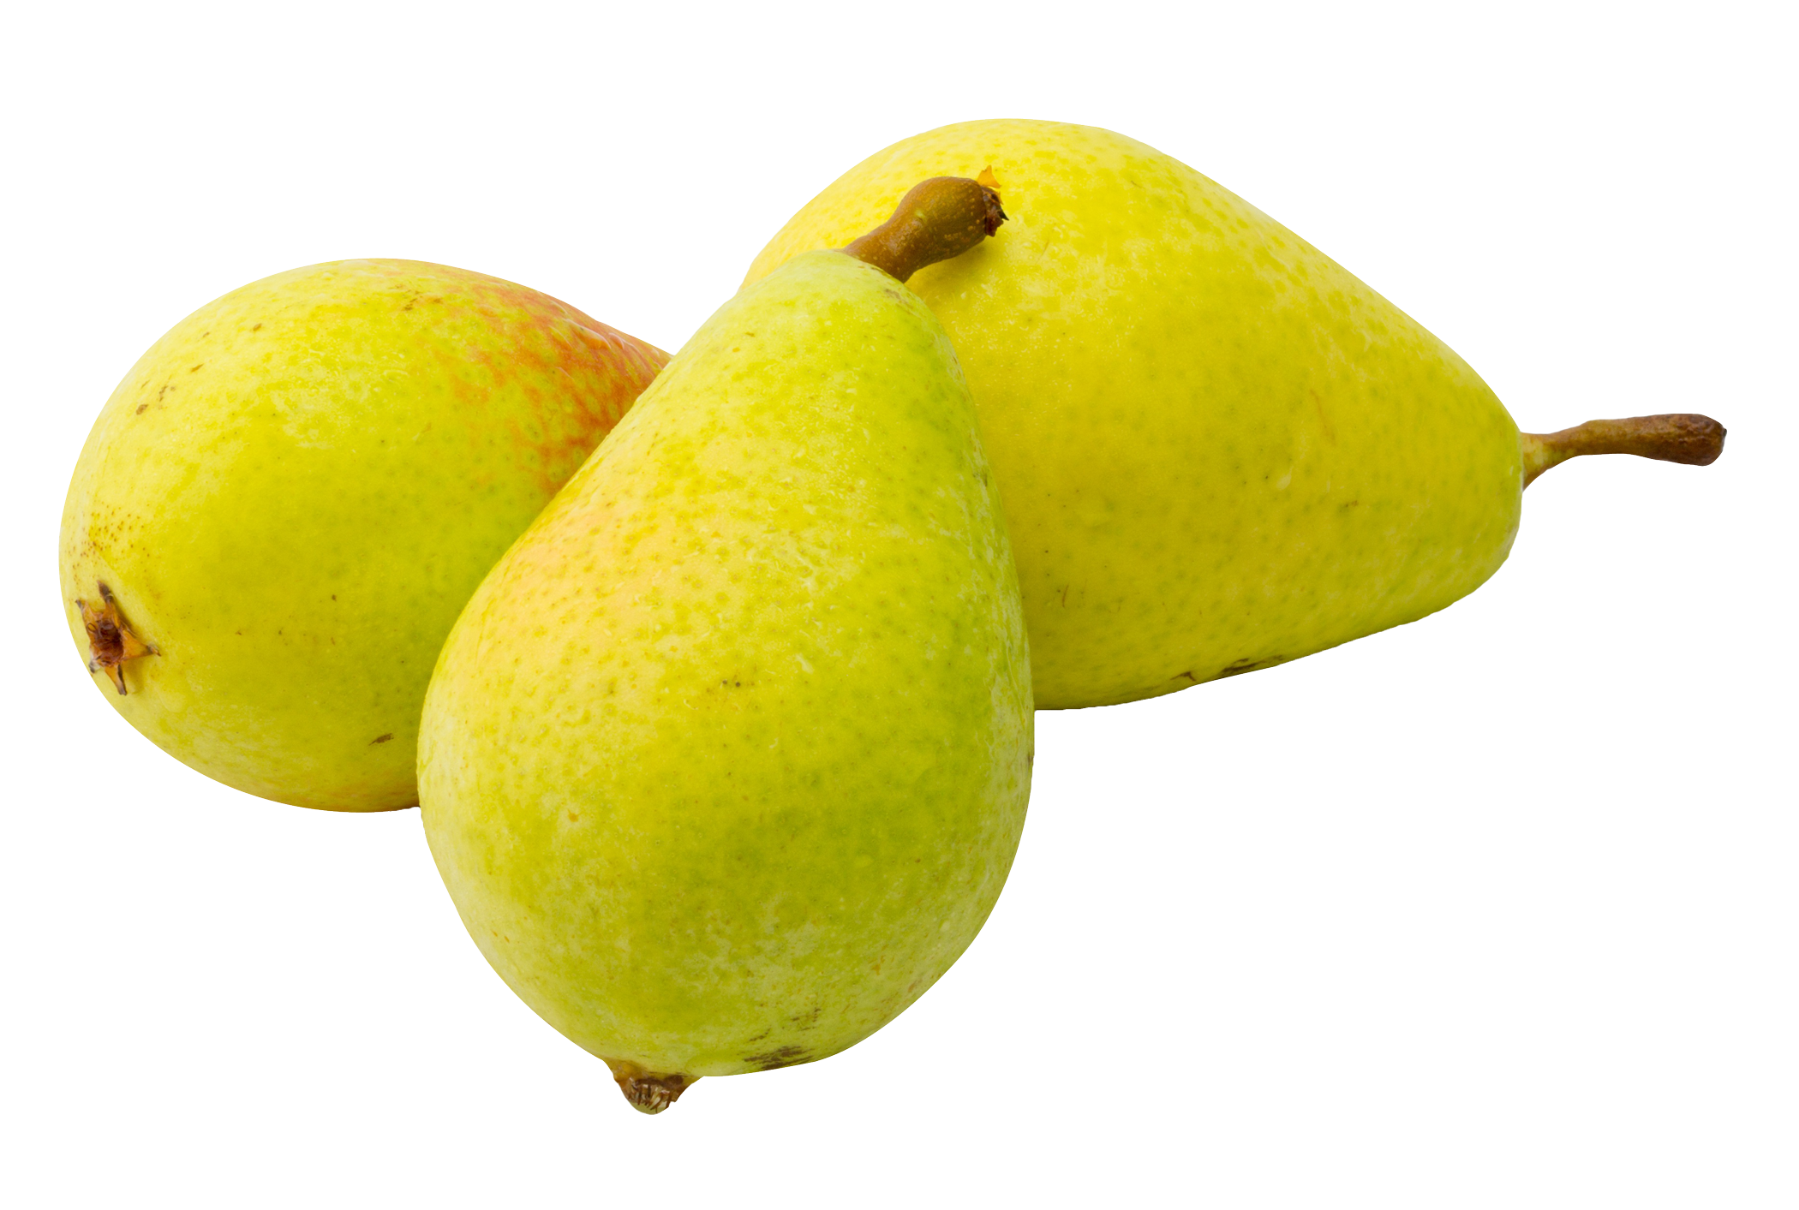
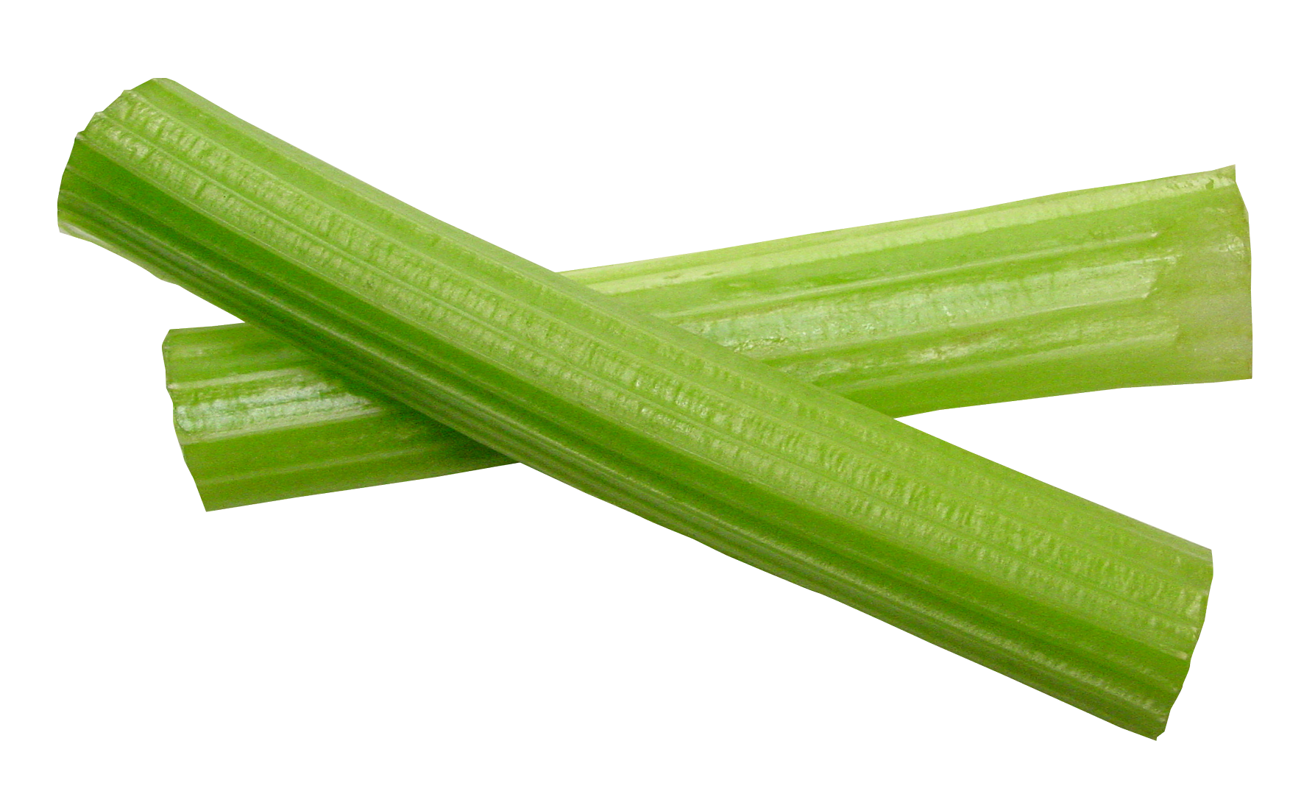
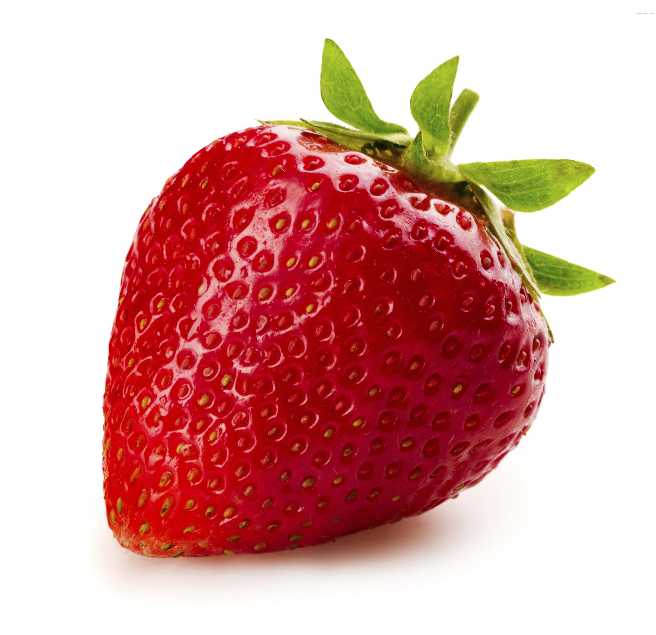
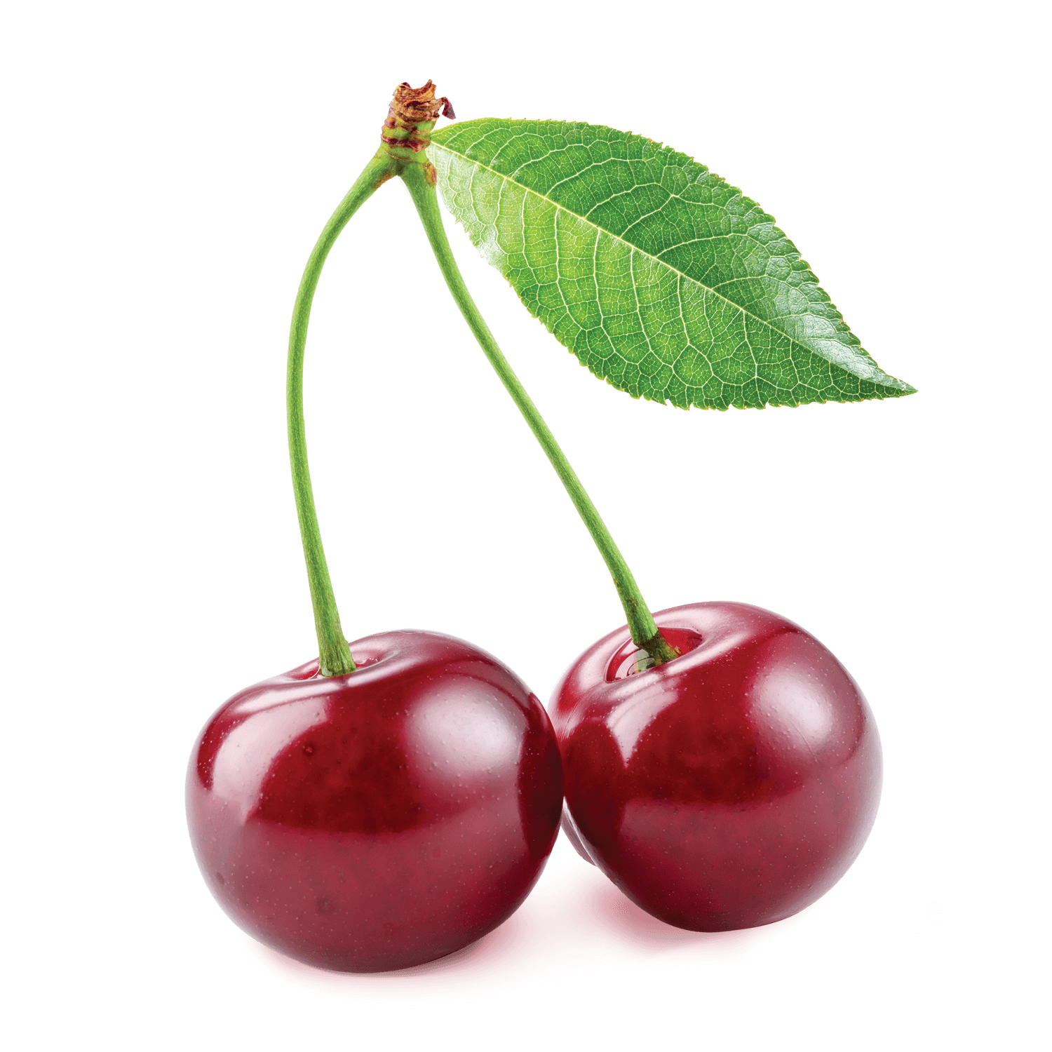
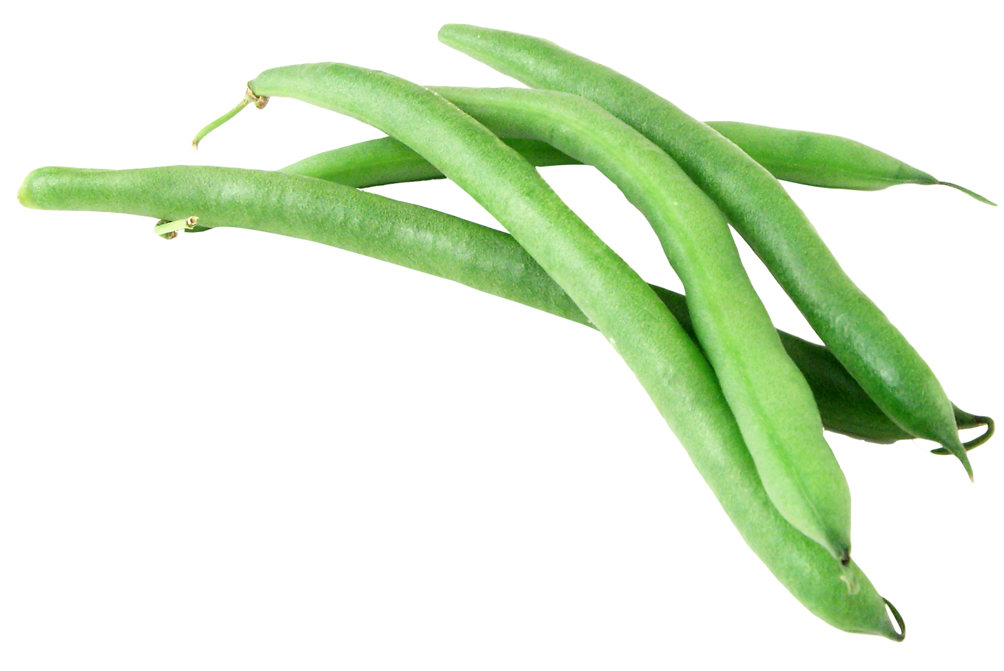
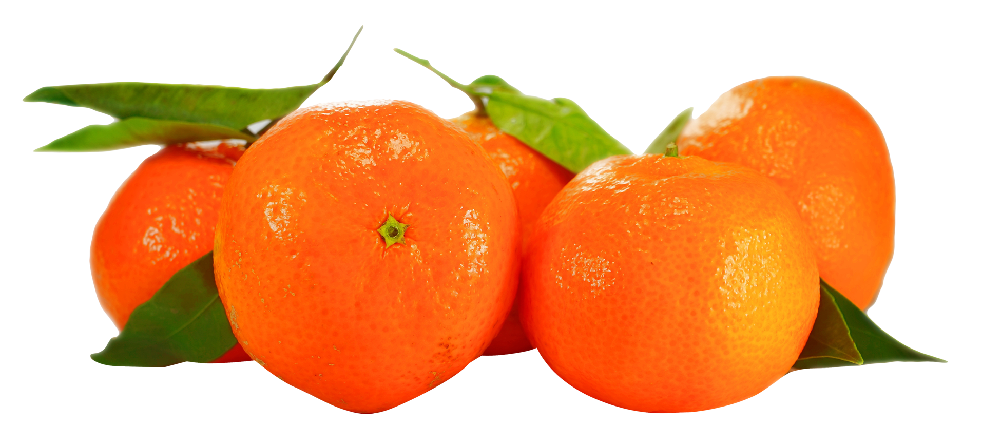
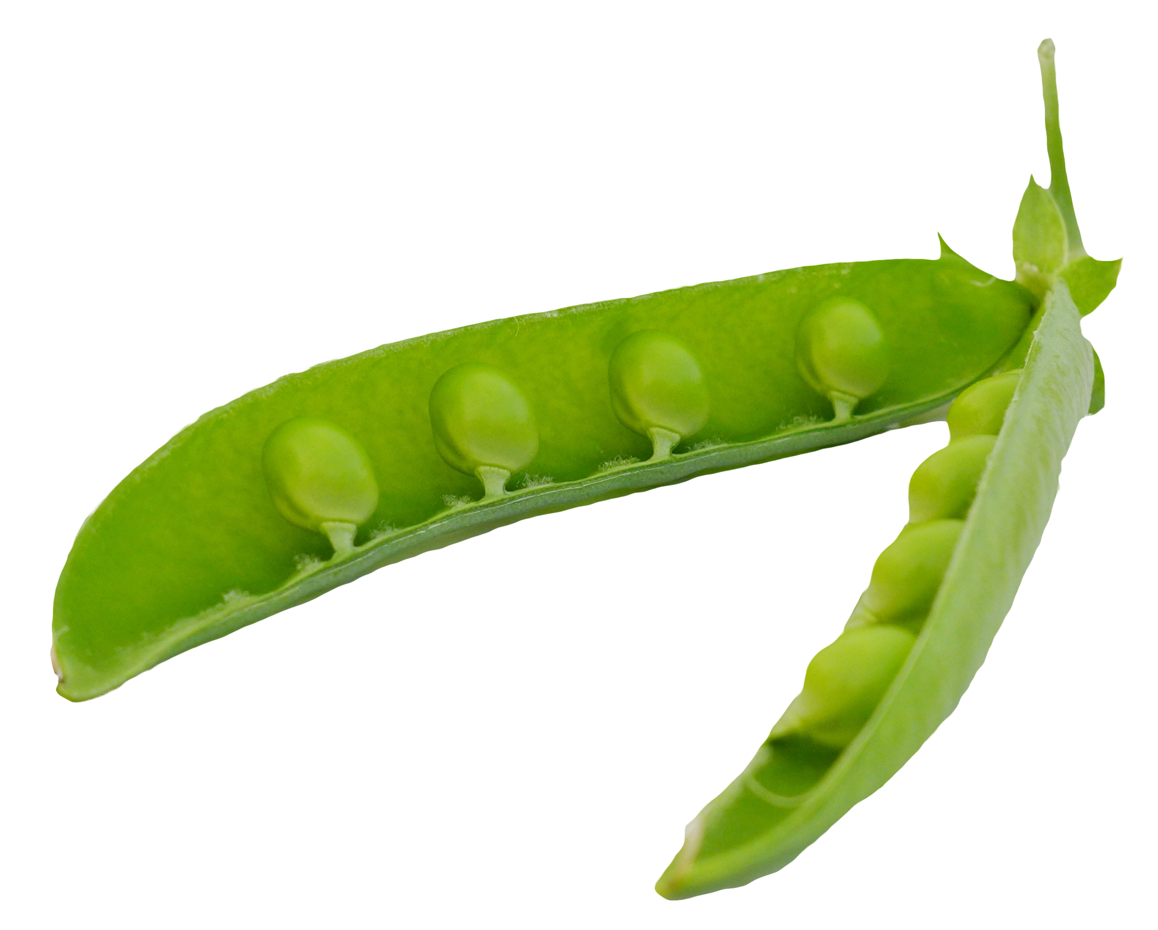
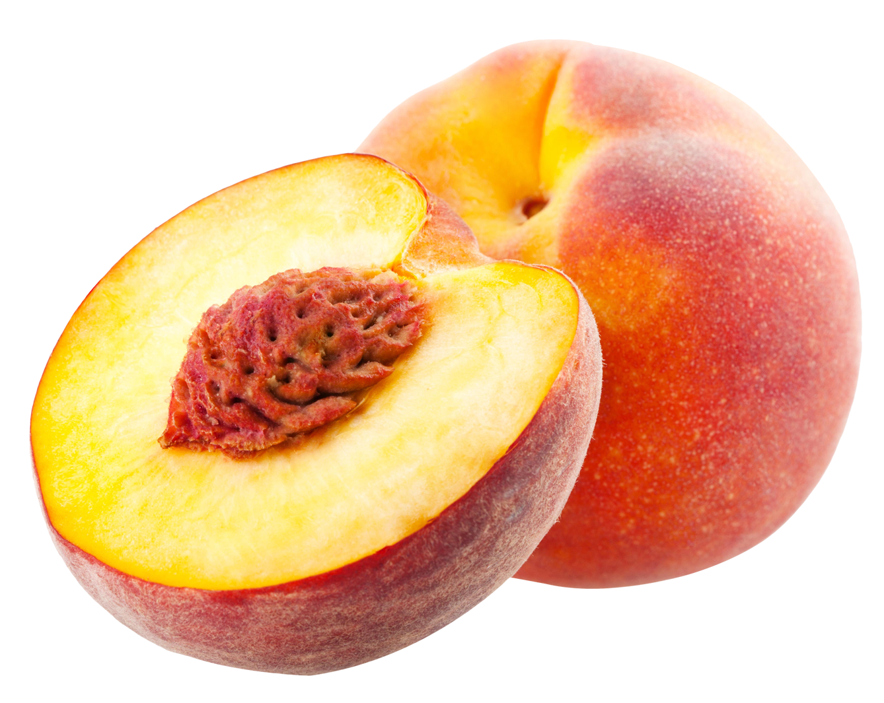
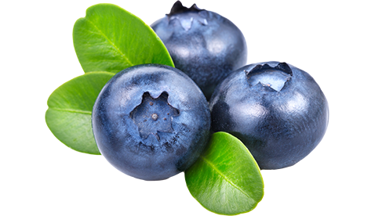
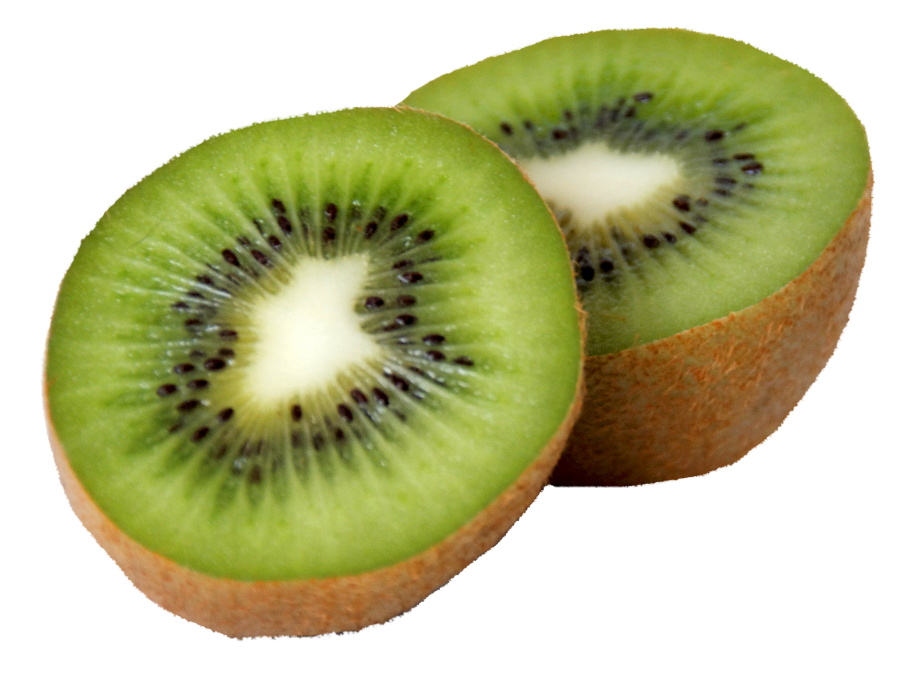
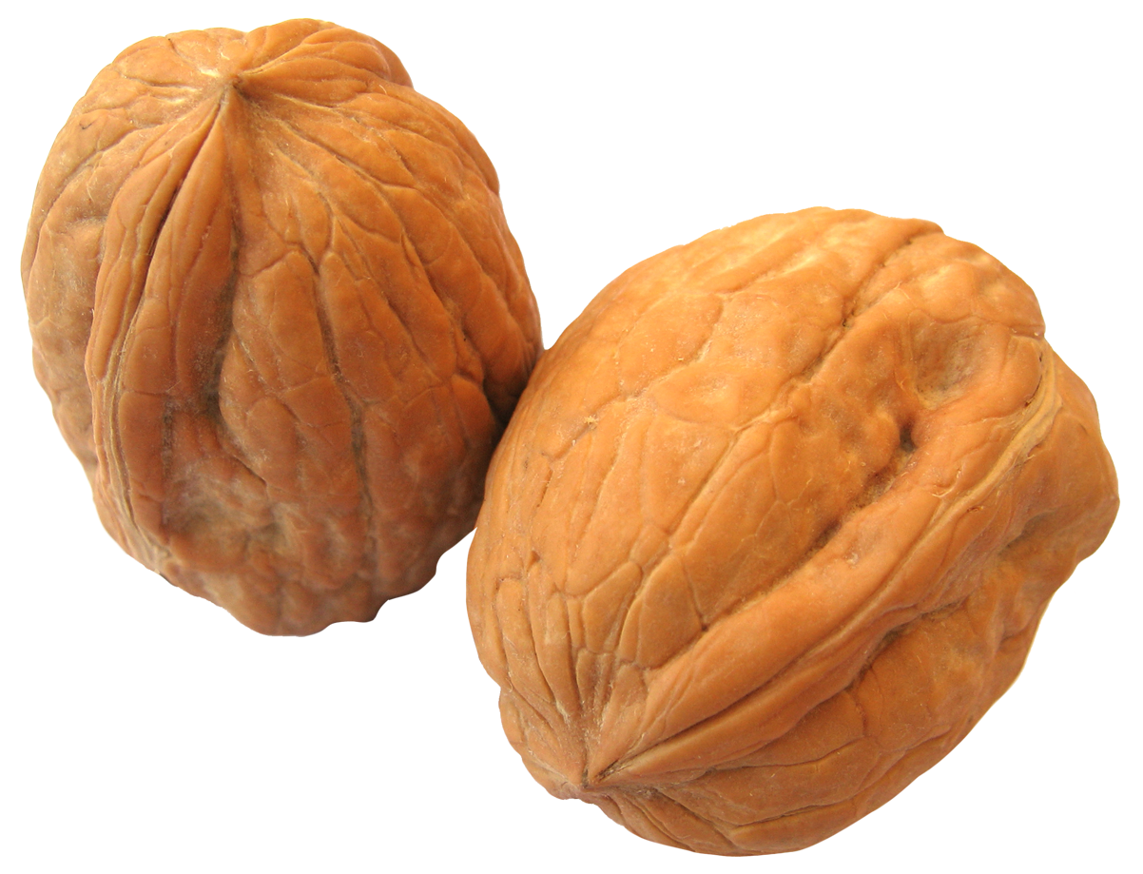
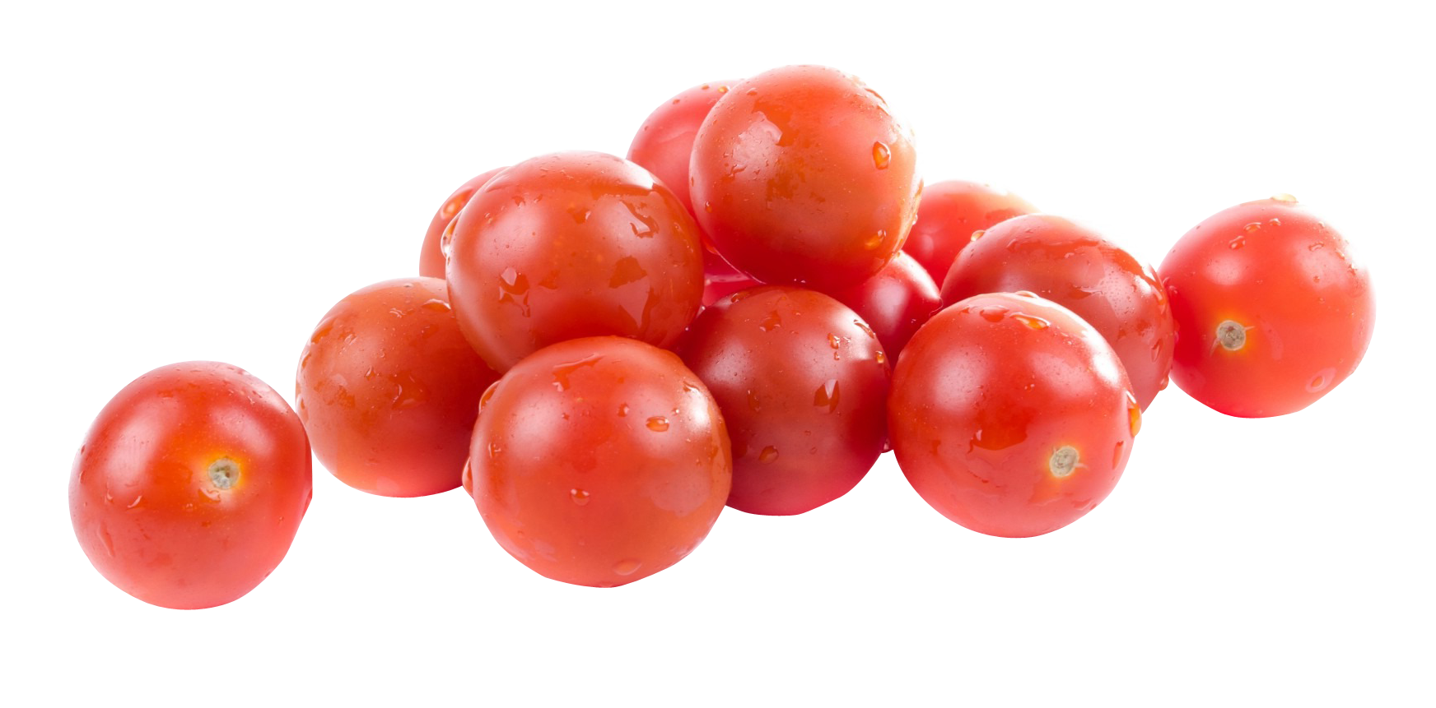
how can you lessen your food impact?
First, buy in season.
Food that is “in season” is food that naturally grows at that time of the year. This means less energy needs to be used in order to grow it.
spring
summer
fall
winter

Slide 26
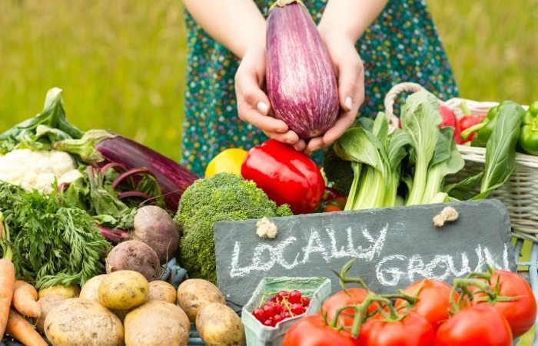
how can you lessen your food impact?
Second, buy local
Local food is being grown right in our own towns. If we buy local food, it doesn’t have to travel as far, reducing the environmental impacts of transporting it.

Slide 27
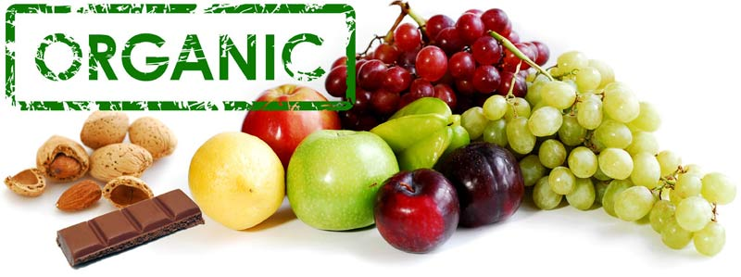
how can you lessen your food impact?
Third, buy organic
Buying organic is usually a bit more expensive. However buying organic means that the practices the farmers use are less harmful to the environment, and to ourselves. It’s better for everyone!

Slide 28
how can you lessen your food impact?
Organic means that the food was produced without:
Pesticides
Man-made fertilizers
Herbicides
Antibiotics
Hormones
Look for this seal on food!

Slide 29
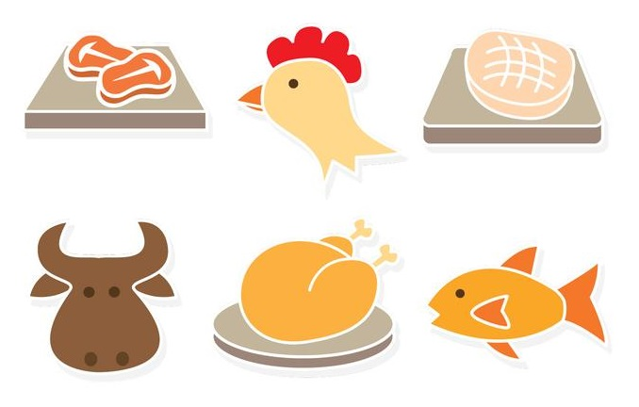
how can you lessen your food impact?
Eat less meat
Meat takes a lot more energy to produce than food from plants like fruits and vegetables. Replacing one dinner a week with a meatless option is a great way to cut down energy impacts of your food.

Slide 30
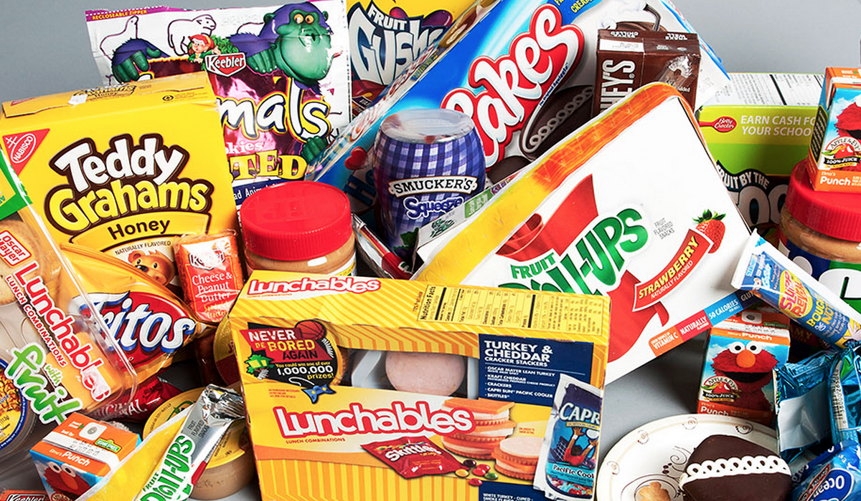
how can you lessen your food impact?
Eat less processed food
This is things like chips, cookies, crackers and so on.
Usually, the more packaging a food has, the more processed it is. Processing food takes a lot more energy than raw foods like fruit or veggies.

Slide 31
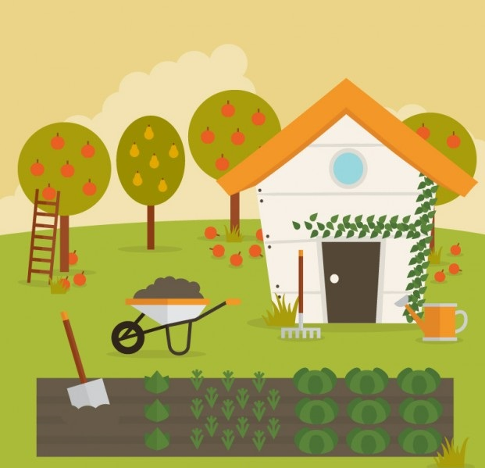
how can you lessen your food impact?
Make sure food is eaten before it goes bad!
Try growing your own food

Slide 32
You have the option to buy a tomato from location A, where it is in season, or Location B where it is not in season. Which tomato requires less energy to be grown?
pop quiz…
Location A.
Location B.
They’re the same.

Slide 33
What is a food mile?
pop quiz…
The number of apples, lined up end to end, to measure a mile.
The distance your food must run in P.E. class.
The distance your food travels from where it’s grown to get to you.
How fast your food gets to you.

Slide 34
Which of the following uses less overall energy and has less environmental impact?
pop quiz…
An apple grown 1000 miles away from the store.
An apple grown 50 miles away from the store.

Slide 35
Which of the following is not a processed food?
pop quiz…
Chips Ahoy.
Honey Nut Cheerios.
An Apple
Frozen vegetables.

Slide 36
Which of the following is a way to reduce your food energy impact.
pop quiz…
Eat less meat
Eat less processed food
Buy in season, local, and organic food.
Grow your own food.
All of these are great!

Slide 37
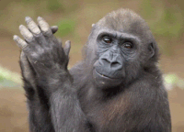
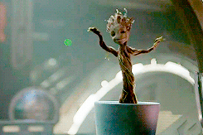
thank you!
Notes:
Put this slide up while you explain answer to previous question.

Slide 38
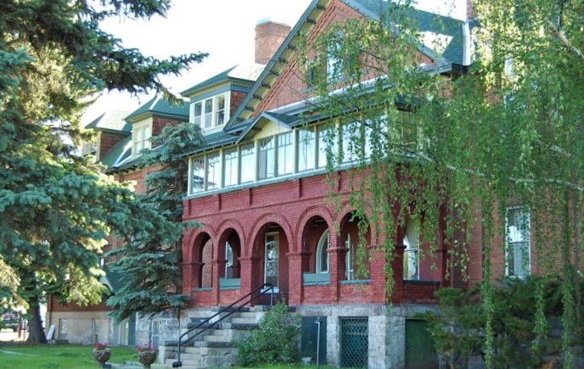
want to learn more?
contact:
name
title
email
(xxx) xxx-xxxx
Our headquarters is located at 3040 Continental Dr. Butte, MT

